Slide 1
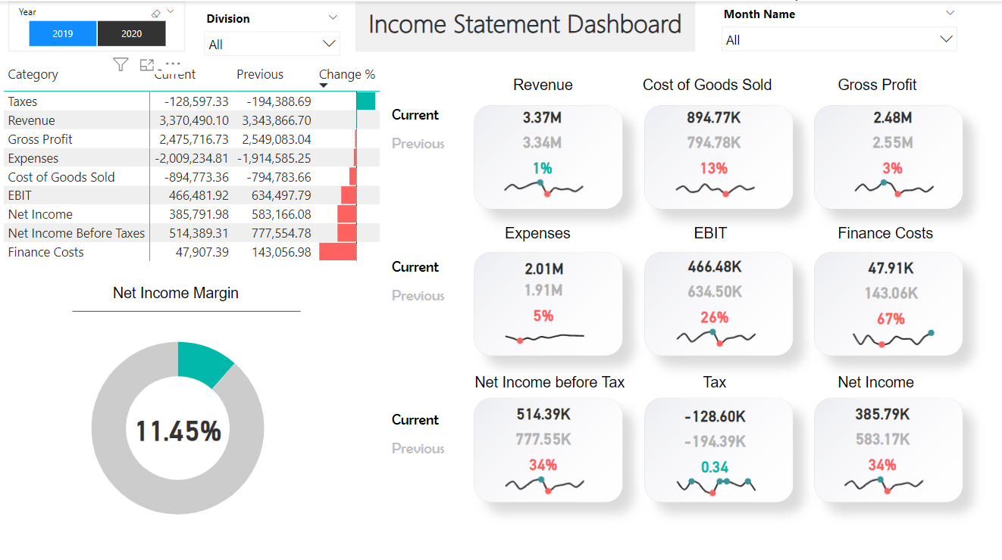
Financial Income Statement Insights
Exploring key insights from Dashoard's income statement data

Slide 2



Introduction
Explore key insights
Understand financial health
Data-driven analysis
Analyze Dishoard's financial income statement to identify trends and assess performance.
Evaluate Dishoard's overall financial stability and position in the market.
Leverage financial data and ratios to conduct a comprehensive, objective assessment.
This introductory slide sets the context for a deep-dive into Dishoard's financial income statement, enabling a thorough understanding of its financial performance and health through data-driven analysis.

Slide 3
Revenue Growth
2018
2020
2022
Launched new product line, driving initial revenue spike.
Pandemic posed challenges, but maintained steady growth.
Introduced subscription model, driving recurring revenue.
2019
2021
2023 (Projected)
Expanded distribution network, boosting sales nationwide.
Acquired smaller competitor, increasing market share.
On track for continued double-digit growth.

Slide 4
“Keep costs under control to protect profit margins.”
WARREN BUFFETT

Slide 5


Expense Breakdown
Expense Category
Percentage of Total Expenses
Cost of Goods Sold
42%
Salaries and Wages
32%
Marketing and Advertising
18%
Other Expenses
8%
*Data from Dishoard's 2022 Annual Financial Report

Slide 6
Profitability Metrics
Percentage values representing the profitability of Dishoard
15%
13%
9%
Net Profit Margin
Return on Assets
Return on Equity

Slide 7



Cash Flow Analysis
Operating Cash Flow
Investment Flexibility
Growth Opportunities
Resilience and Stability
Dishoard consistently generates robust cash flow from its core operations, reflecting its strong profitability and efficient working capital management.
The healthy operating cash flow provides financial flexibility to Dishoard, allowing it to allocate resources for strategic investments and growth initiatives without straining liquidity.
With ample operating cash flow, Dishoard can explore and capitalize on growth opportunities, such as expanding into new markets, acquiring complementary businesses, or investing in research and development.
The steady cash flow from operations enhances Dishoard's financial resilience, enabling it to weather economic downturns and maintain operational continuity while pursuing long-term growth strategies.

Slide 8
Liquidity Ratios
Current Ratio
A measure of a company's ability to pay off its short-term liabilities with its current assets. It is calculated by dividing current assets by current liabilities.
Quick Ratio
Similar to the current ratio, but excludes inventory from current assets as inventory is considered less liquid. It provides a more conservative measure of liquidity by excluding assets that may take longer to convert into cash.
Cash Ratio
The most stringent measure of liquidity, it considers only cash and cash equivalents as current assets. It is calculated by dividing cash and cash equivalents by current liabilities.

Slide 9
Leverage and Solvency
Debt-to-Equity Ratio
Interest Coverage Ratio
This ratio measures the relationship between Dishoard's total debt and total equity, indicating the degree of financial leverage employed by the company.
This ratio calculates Dishoard's ability to pay interest expenses on outstanding debt by comparing its earnings before interest and taxes (EBIT) to its interest expenses.
Manageable Debt Level
Financial Obligations
The ratios suggest that Dishoard has a balanced capital structure and a manageable amount of debt relative to its equity and earnings.
The company's interest coverage ratio indicates that it generates sufficient earnings to comfortably meet its interest payment obligations, reducing the risk of default.

Slide 10


Key Strengths
Brand Recognition
Product Portfolio Diversity
Supply Chain Efficiency

Slide 11






Areas for Improvement
1
Streamline inventory management processes
2
Optimize marketing budget allocation
3
Identify and pursue new revenue streams
4
Enhance operational efficiency
5
Strengthen customer relationships
6
Explore strategic partnerships

